Slide 1
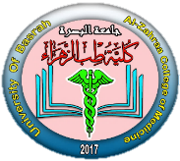
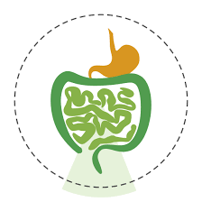
Lecture Title: Basic structures and processes
University of Basrah Al-zahraa medical college
Ministry of higher Education and Scientific Research
Module: Gastro-Intestinal Tract (GIT)
Semester: 4
Session: 1
Lecture Duration: 1h.
This Lecture was prepared by module Staff:
Dr. Wisam Hamza Dr.Nawal Mustafa Dr. Mayada Abullah
Dr. Mohammed Al Hijaji Dr. Nada Hashim Dr. Hamid Jadoaa
Dr. Jawad Ramadan Dr. Ihsan Mardan Dr. Amani Naama
Dr. Hussein Katai Dr. Miami yousef Dr. Ilham Mohammed
Dr. Wameedh Alqatrani Dr. Farqad Alhamdani
Dr. Nehaya Minahi Dr. Zaineb Ahmed
Dr. Haithem Almoamen Dr. Ansam Munathel
Dr. Sadek Hassan Dr. Raghda Shaaban
This Lecture was loaded in blackboard and you can find the material
Porth, CM. Essentials of Pathophysiology. 3rd Edition, Lippincott Williams & Wilkins [2011];
Gastrointestinal system – crash course. 3rd Edition, Mosby [2008]
For more detailed instructions, any question, or you have a case you need help in, please post
to the group of session

Slide 2
University of Basrah Al-zahraa medical college
Ministry of higher Education and Scientific Research
Learning Objectives (LO)
1- Describe the overall processes of the GI tract.
2- Outline the broad functions of the various regions of the GI tract
3- Describe the general structural plan of the alimentary canal.
4- Describe regional variation in macro- and microstructure of each of the major divisions of the alimentary canal that relate to functional adaptations for transport, storage, digestion and absorption.
5- Describe the fluid balance of the gut.
6- Describe the properities of the enteric nervous system, and its relationship to the autonomic nervous system.
7- Describe the role of hormones and other peptides which affect the motility and secretion in the gut.

Slide 3
Functions of the gastro-intestinal system LO.1
University of Basrah Al-zahraa medical college
Ministry of higher Education and Scientific Research
The functions of the tract can be described in terms of four processes:
Digestion
Secretion
Motility
Absorption

Slide 4
University of Basrah Al-zahraa medical college
Ministry of higher Education and Scientific Research
Functions of the gastro-intestinal tract LO.1
To breakdown ingested food into molecules small enough to be absorbed by the body – digestion.
Digestion is accomplished by the action of HCl, bile and a variety of enzymes secreted by exocrine glands – secretion.
Contractions of the smooth muscles in the walls of the tract, mix and move the ingested food from mouth to anus – motility.
The products of digestion are then taken into the blood by the process of absorption.

Slide 5
University of Basrah Al-zahraa medical college
Ministry of higher Education and Scientific Research
LO.2, LO.5
Each day we ingest about 1kg of food and about a litre of liquids.
The food is "fluidised" and mixed with:
1.5 Litres of saliva.
6 litres of secretions from the stomach, liver, pancreas and intestines.

Slide 6
University of Basrah Al-zahraa medical college
Ministry of higher Education and Scientific Research
LO.2, LO.5
Of the resulting 9.5L all but 1.5L ml are absorbed by the small intestine.
The remaining fluid is absorbed in the large intestine to leave about 150 g of semi-solid faeces.
The whole system is a complex "flow reactor" with a number of anatomically and physiologically specialised regions which perform particular functions.
It is designed so that its secretions and contractions are controlled to maximise digestion and absorption.

Slide 7
University of Basrah Al-zahraa medical college
Ministry of higher Education and Scientific Research
Structural adaptations of the Digestive system LO.3, LO.4
From the oral cavity (oropharynx) to the anus, the alimentary canal consists of four layers;
from within outwards, they are:
1. Mucosa or mucous membrane (consisting of a lining epithelium, connective tissue and thin layer of smooth muscle)
2. Submucosa (a zone of fibroelastc tissue with vessels, nerves of the submucosal plexus, leucocytes and fat cells),

Slide 8
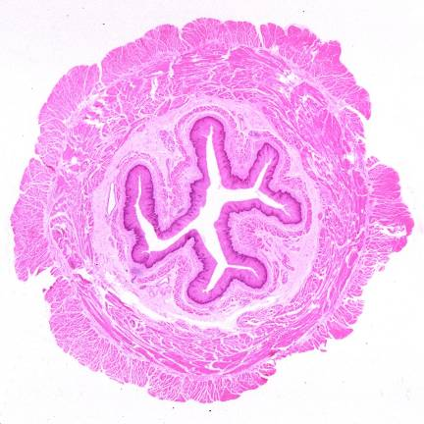
University of Basrah Al-zahraa medical college
Ministry of higher Education and Scientific Research
3. Muscularis externa (consisting of an inner circular and outer longitudinal layer of smooth muscle with the myenteric plexus lying in between the muscle layers).
4. Serosa or adventitia (a thin outer covering of connective tissue).

Slide 9
University of Basrah Al-zahraa medical college
Ministry of higher Education and Scientific Research
Autonomic nervous system/enteric system LO.6
Secretion and motility of the gut are regulated by reflexes in:
Autonomic nervous system/enteric system
Hormones
They are activated by the contents of the gut and operate to maintain optimum conditions for digestion and absorption.

Slide 10
University of Basrah Al-zahraa medical college
Ministry of higher Education and Scientific Research
Autonomic nervous system/enteric system LO.6
Apart from the voluntary control of the muscles of chewing and of defecation, the nervous control of the motility of the gut is entirely autonomic.
The enteric nervous system is made up of two nerve plexuses in the wall of the gut which may act independently of the CNS (short reflex pathway). This activity may be modified by both branches of the ANS (long reflex pathway).

Slide 11
University of Basrah Al-zahraa medical college
Ministry of higher Education and Scientific Research
Hormones LO.7
A dozen or more peptide hormones are released by endocrine cells in the walls of the gut.
Some have a paracrine action, others have true endocrine action.
Comprise two structurally related "groups" the gastrin group and the secretin group.
These hormones are released from one part of the gut to affect the secretions or the motility of other parts.

Slide 12
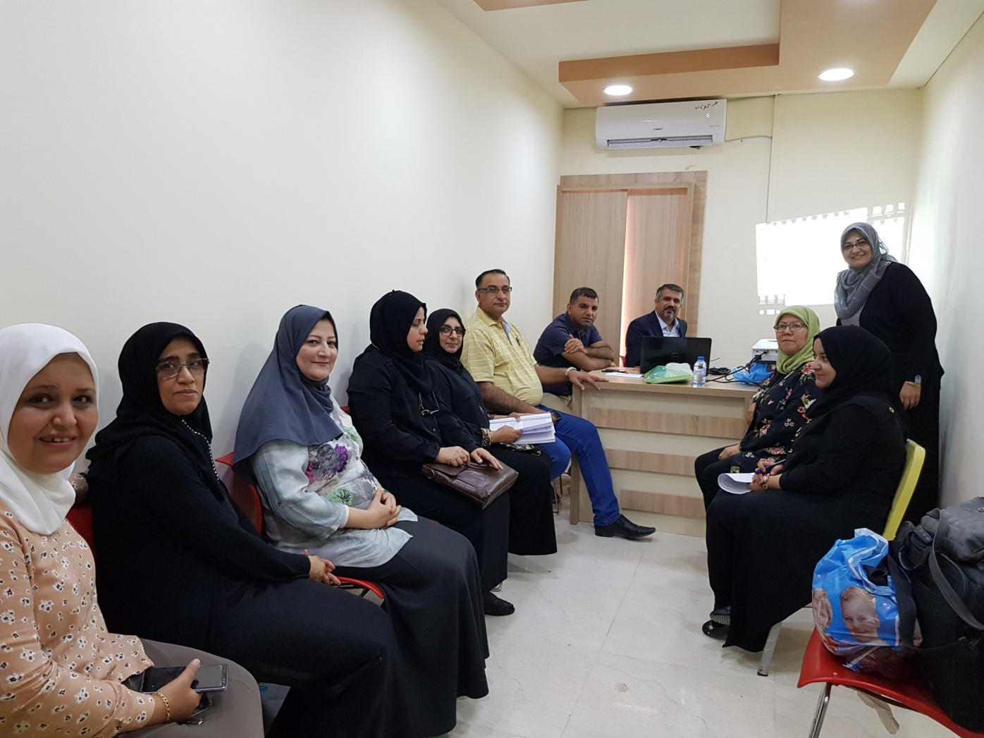
GIT Module Staff wish you the best

